Slide 1
YOUTUBE DATA HARVESTING AND WAREHOUSING
CAPSTONE PROJECT:
SUJITHA S

Slide 2

AIM:
This project aims to develop a user-friendly Streamlit application that utilizes the Google API to extract information on a YouTube channel, stores it in a MongoDB database, migrates it to a SQL data warehouse, and enables users to search for channel details and join tables to view data in the Streamlit app.

Slide 3

STEPS TO BE FOLLOWED:
Set up a Streamlit app
Connect to the YouTube API
Store data in a MongoDB data lake
Migrate data to a SQL data warehouse
Query the SQL data warehouse
Display data in the Streamlit app

Slide 4
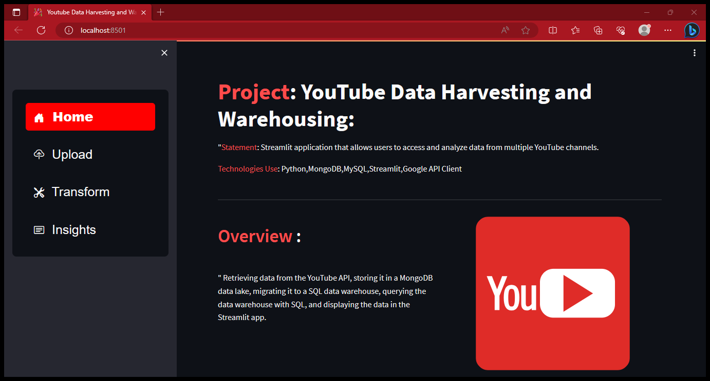
STREAMLIT PAGE
This is my YOUTUBE DATA HARVESTING AND WAREHOUSING Streamlit app.

Slide 5
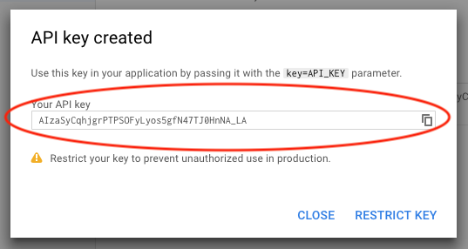
YOUTUBE API KEY:
The API provides the ability to retrieve feeds related to videos, users, and playlists.
We can create our own YOUTUBE API KEY from Google Cloud Platform.
Image given below is the API KEY for YOUTUBE Data API V3.

Slide 6
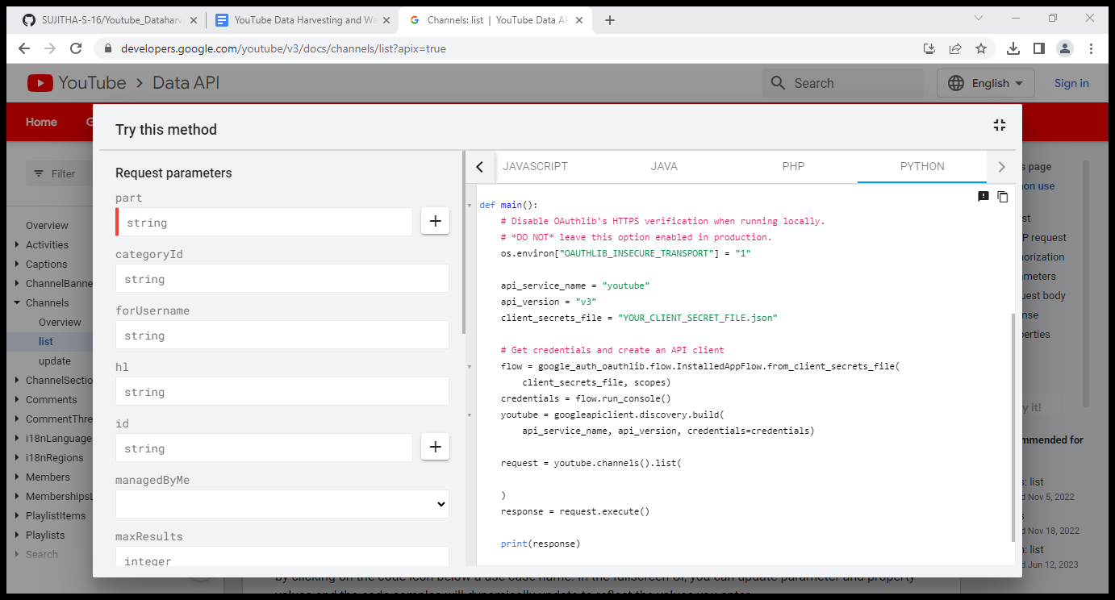
RETRIEVE DATA FROM YOUTUBE API
Select any one YouTube channel and get the channel id
Refer YouTube API documentation , from the document we can get the codes for data we need.
In this project , I collected Channel details, Playlist details , Videos details, Comment details.
Using Functional Blocks I created functions for the details I need , So that I can call it whenever I needed and it can be used for any YouTube channel.

Slide 7
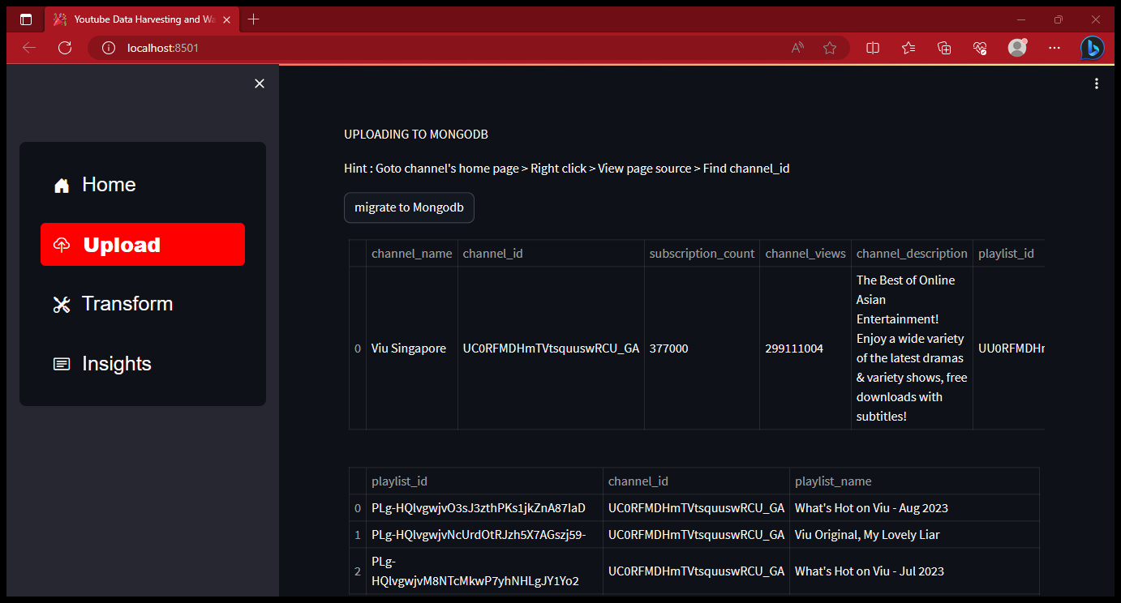
STORING IN MONGODB
Store all the data in MongoDB that we collected from the previous step.
Create a collection , insert them into the database .

Slide 8
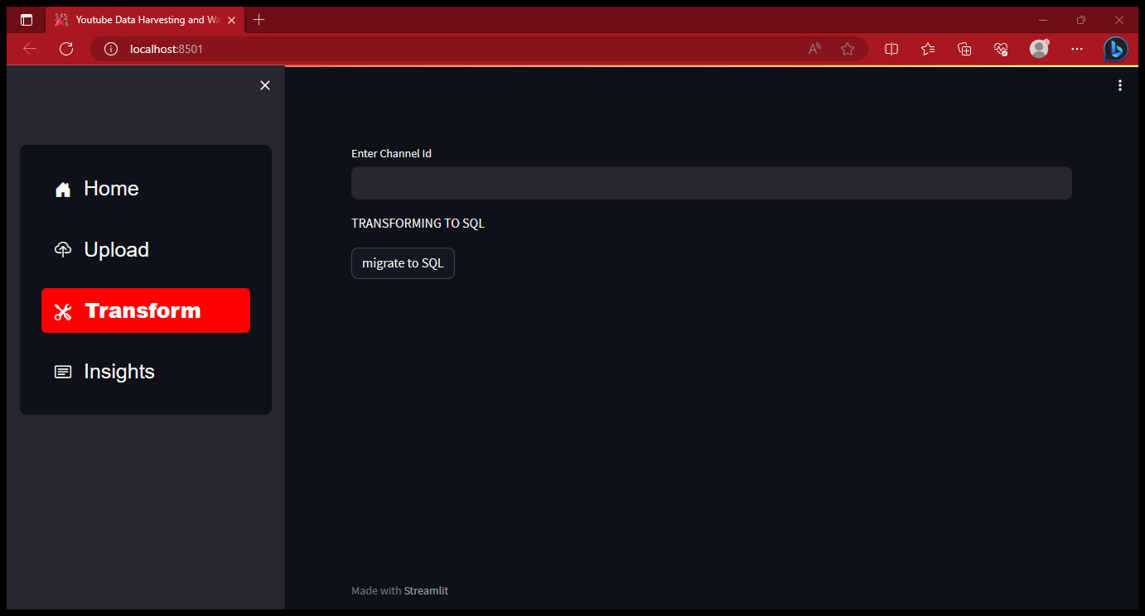
TRANSFER TO SQL
After you've collected data for multiple channels, you can migrate it to a SQL data warehouse. Here I used MySQL .
Create Tables for the required details and use the tables for the queries that have to be answered for the questions in INSIGHT PAGE.

Slide 9
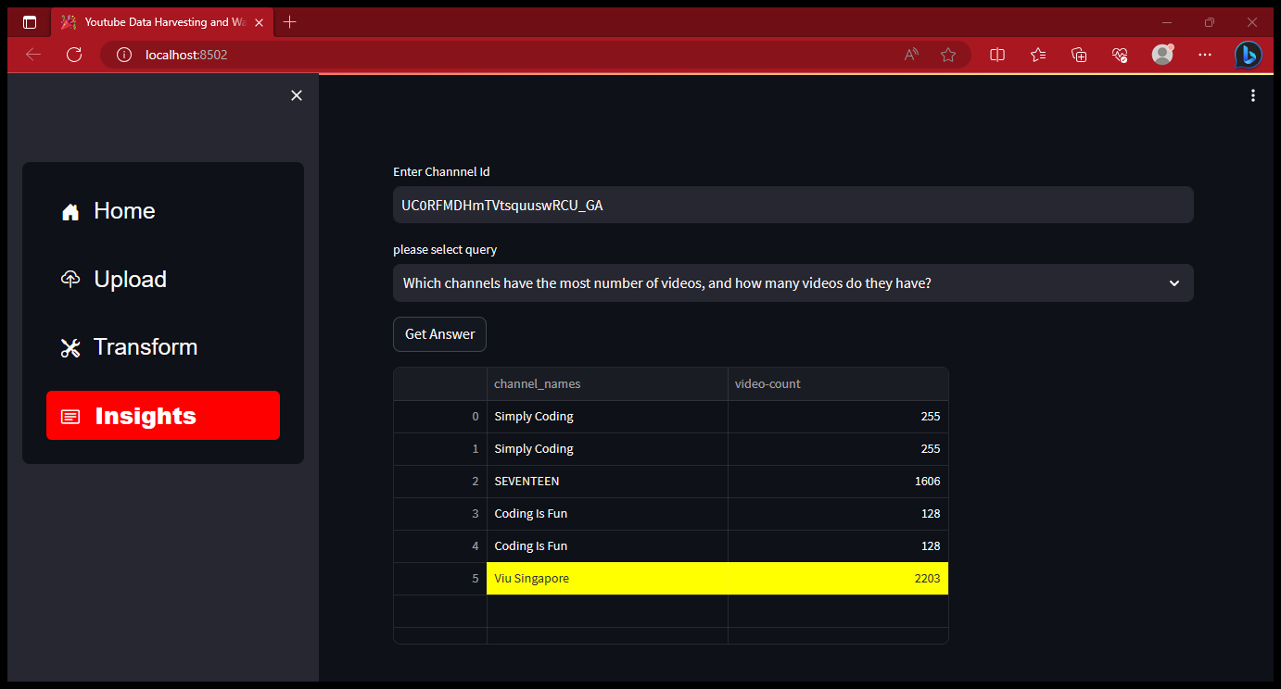
SQL QUERY

Slide 10
THANK YOU

